Slide 1
Telerik Test Studio
Day-1

Slide 2
Day 1 Topics
Telerik IDE
Sections and Uses
Recording Basics
DOM Explorer
Objects
Common Objects
Tables in DOM
Object Management in IDE
Reusability and URL independence
Key Stroke and Mouse Click

Slide 3
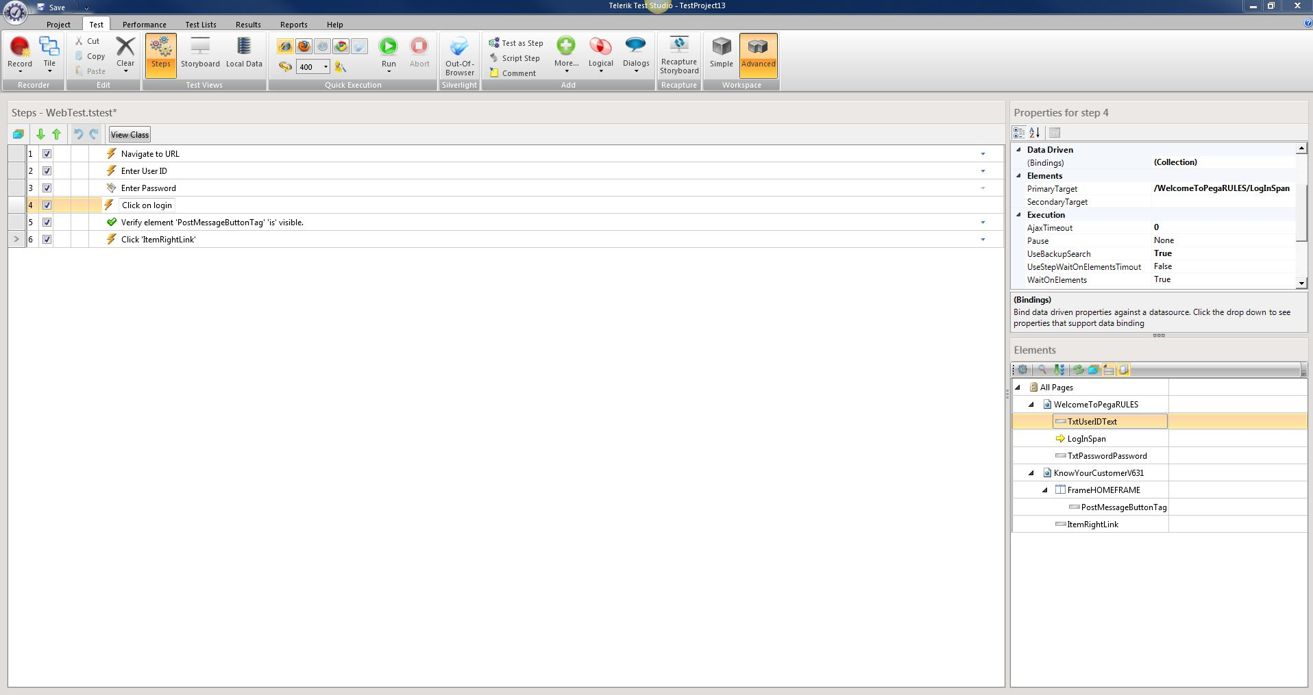
Telerik IDE-Sections
Record and Playback Options
Test Steps
Properties of Objects or Steps
Recorded Objects

Slide 4
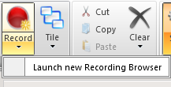
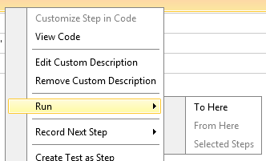
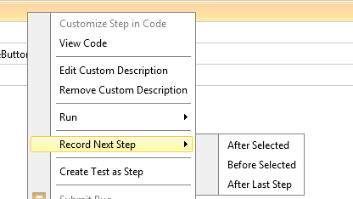
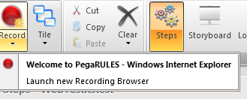
Recording In IDE

Slide 5
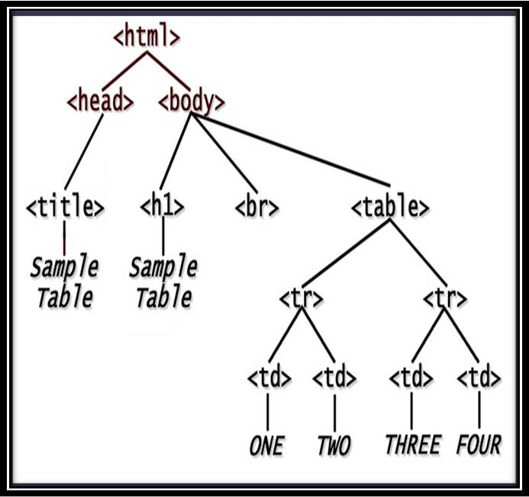
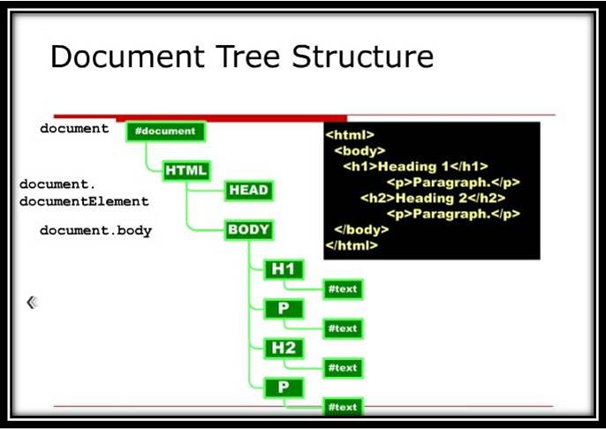
DOM

Slide 6
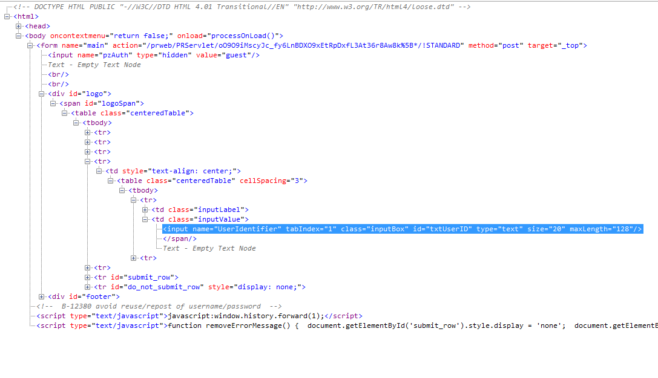
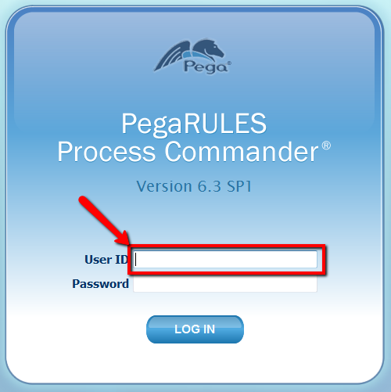
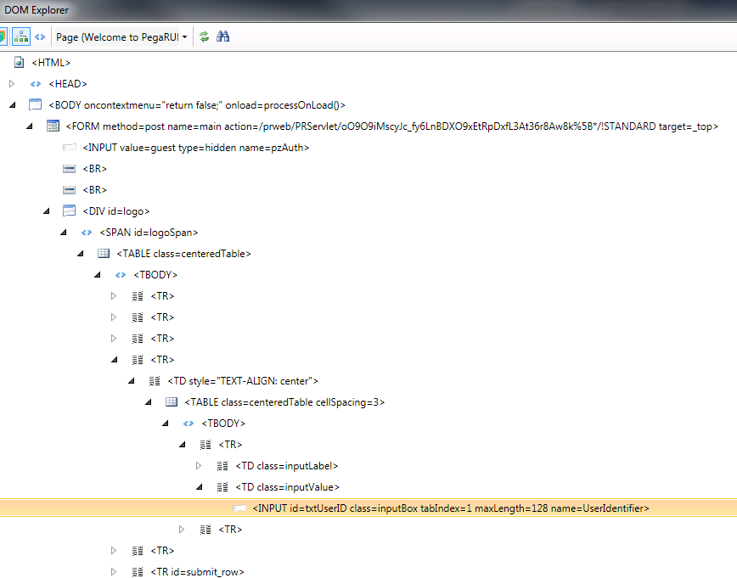
Object Under Consideration
IE DOM Explorer
Telerik DOM Explorer

Slide 7


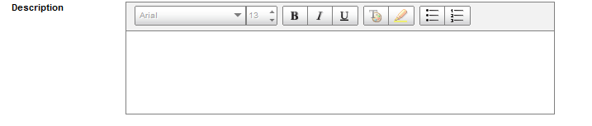
Objects In Telerik
Text Box
Radio Button
Text Area

Slide 8


Drop Down
<select name="$PpyWorkPage$pFactorTypeInsName" title="GPCI" id="FactorType" style="width: 170px;" size="0" PN=".FactorTypeInsName" DSReadOnly="false" DSHidePrompt="false" DSEnableCache="false" DSWaitTime="" DSOnDemandCaption="" DSLoadMode="Auto" DSDelimiter=" " DSTargetID="FactorTemplate" DSParentID="" DSDefaultCaption="Select a Pricing Table type..." DSDefault="" DSRefreshOnLoad="" DSValue="pxInsName" DSCaption="Name" DSSource="pyActivity=PegaHC-NCI-Work-Factor.FilterFactorTypes" fixedWidth="true" DSTarget="[object]" DSSelectedTempValue="GPCI!ALL!PROFESSIONAL">
Button
<div class="pzbtn-mid" data-click="...">Check Box
Image Capture
<img class="pzbtn-img" src="webwb/detectconflict_12252867685.png!!.png" complete="complete" data-click="."/>

Slide 9
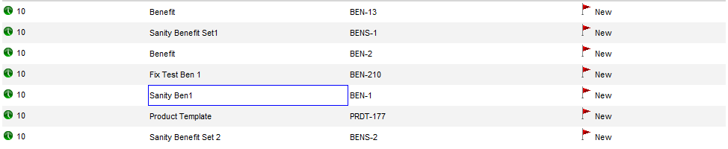
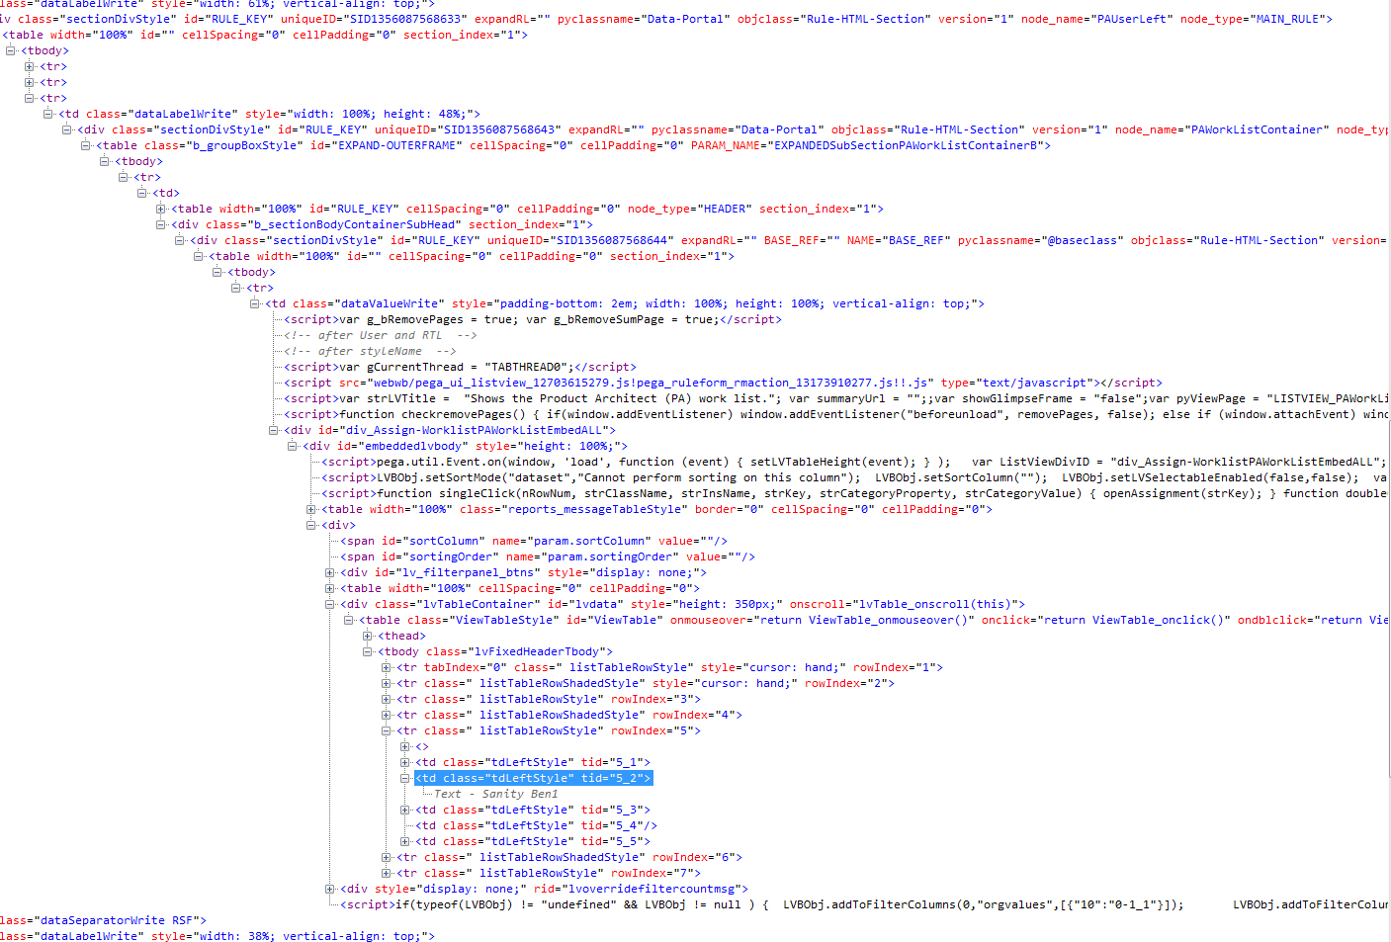
Table

Slide 10
Discussion

